Slide 1

Exam Case
CANDIDATE'S INSTRUCTIONS
An anxious looking woman approaches you with a concern. Assist her in solving her problem. Give her your recommendation as you would in practice.
Time Frame: You have 7 minutes to complete this station.
References: E-minor ailments

Slide 2
Exam Case
Patient Record (Profile) Information:
Patient Name: Erica Martin
Gender: Female
Age: 2&1/2 years old
Allergies: none known
Medical History: None

Slide 3
On the table
Hydrocortisone Cream 0.5%
Miconazole Cream
Clotrimazole cream
Zinc oxide (17%)
Zinc Oxide (40%)
Talc
Calamine lotion

Slide 4
Exam Case
SP instructions:
SP has to look worried and anxious. He need some advise for his child
Opening statement “Could you please recommend something for diaper rash”?
Upon asking, SP says ‘my child is crying quite often. Her diaper area is red It looks very painful to see. This is happening since last 1 to 2 days.
Only if the candidate asks say. Can you describe your child symptoms of diaper rash? Say it is beefy red rash. If asked say I did observe a few satelite shaped spots. Only if asked say-No pus no boils, no macerations as yet. no fever or other symptoms, she had loose stools 2 days back now no loose stools
First time getting it- well she had it when she was 1 year old.
If candidate asks about the medications, SP says her child is NOT on medication
Diaper change questions: changes frequently, uses alcohol wipes cleans area, applies ZNO 17%
Allergies: not known
Medical conditions: none and healthy
If candidate says “ I request you to go to the doctor”, SP says “I will. But can you at least give me something to help me right now?”

Slide 5
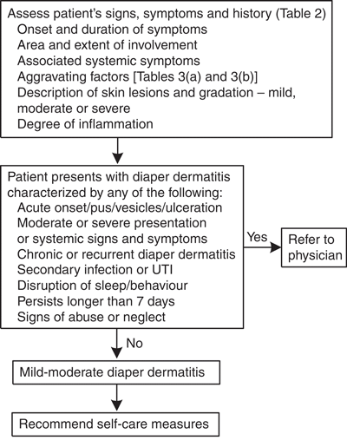
For assesors

Slide 6
Exam Case
:>profiling of patient- allergies, age relates diaper rash possibly to loose stools.
: differential diagnosis, red flags , fungal infection
: suggests: ZNO/calamine lotion + anti fungal
Marginally solved
:: differential diagnosis, red flags , fungal infection
: suggests: ZNO 40%/calamine lotion/ HC 1% provided not to split skin + anti fungal

Slide 7
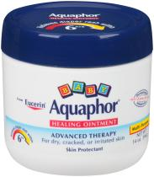
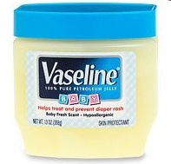
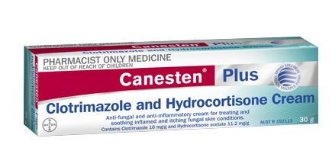

Slide 8
Pharmacy PREP OSCE Check List Diaper rash
Communication skills (checklist) |  |  | Outstanding | Good | Acceptable | NOT Acceptable
Opening Statement (respond to patient clue, good listener, did not interrupt patient, engaging). Non-verbal Skills (eye contact, gesture, posture), Identified patient? |  |  | 4 | 3 | 2 | 1
Information gathering process. (Asked M-A-M-A) allergies, medicine history, medical conditions. Builds trust and confidence with patient, Specific lifestyle such as alcohol and smoking habits prn; and/or other considerations relevant to the purpose of the case. |  |  | 4 | 3 | 2 | 1
Discuss Follow up/Monitoring relevant to case |  |  | 4 | 3 | 2 | 1
Time to check references, and use of proper references |  |  | 4 | 3 | 2 | 1
Overall time management |  |  | 4
Overall communications |  |  | Outstanding (20) | Good (15-20) | Acceptable (12-14) | (<14) NOT Acceptable
Problem Solving (checklist) |  |  | Fully solved (FS) | Marginally solved (MS) | Marginally unsolved (MU) | Unsolved (U)
key elements of the counseling task 1.Recommend OTC and provides rationale for OTC recommendation (ZnO, calamine + antifungal) 2. Explain red flags and advise to go see doctor if any of them occur 3.Non pharms for diaper rash 4. Explain sign and symptoms of Diaper rash |  |  | All key points covered | 3 key points were covered from 4 point | 2 key points were covered from 4 point | Improper Recommendation
Misinformation? | O | Put patients in to risk? |  |  |  | O
Overall Performance | Superior(O+FS) | Good(G/A +FS) | Fair(A +MS/MU) | Need to improve(U+MU/U)

Slide 9

Pharmacy PREP OSCE Check List. Case.
Communication skills
Patient Centred. Opening Statement (respond to patient clue, good listener, did not interrupt patient, engaging). Non-verbal Skills (eye contact, gesture, posture), Identified patient? Understands the sequence of problem
Information gathering process. (Asked M-A-M-A) allergies, medicine history, medical conditions. Builds trust and confidence with patient, Specific lifestyle such as alcohol and smoking habits prn; and/or other considerations relevant to the purpose of the case.
Discuss Follow up/Monitoring relevant to case
Time to check references, and use of proper references and Overall time management
Overall Communications | Acceptable 4/4 |  | Marginally Acceptable 3/4 |  | Marginally unacceptable 2/4 |  | Unacceptable 1-0/4
Problem Solving
key elements of the counseling task Identifies the drug-related problem: cotrimoxazole – ramipril drug interaction. • Explains the mechanism of the interaction: cotrimoxazole might increase risk of hyperkalemia • Explains probable outcome of the interaction: expect an increased level of potassium leading to cardiac and renal problems • Recommends to change the drug to macroBid 100 mg BID for 5 days.
Overall Problem Solving |  | Fully solved 4/4 |  | Marginally solved 3/4 |  | Marginally unsolved 2/4 |  | Unsolved 1-0/4
Note. |  | Misinformation? |  |  |  | Put patients in to risk? |  | O

